Slide 1

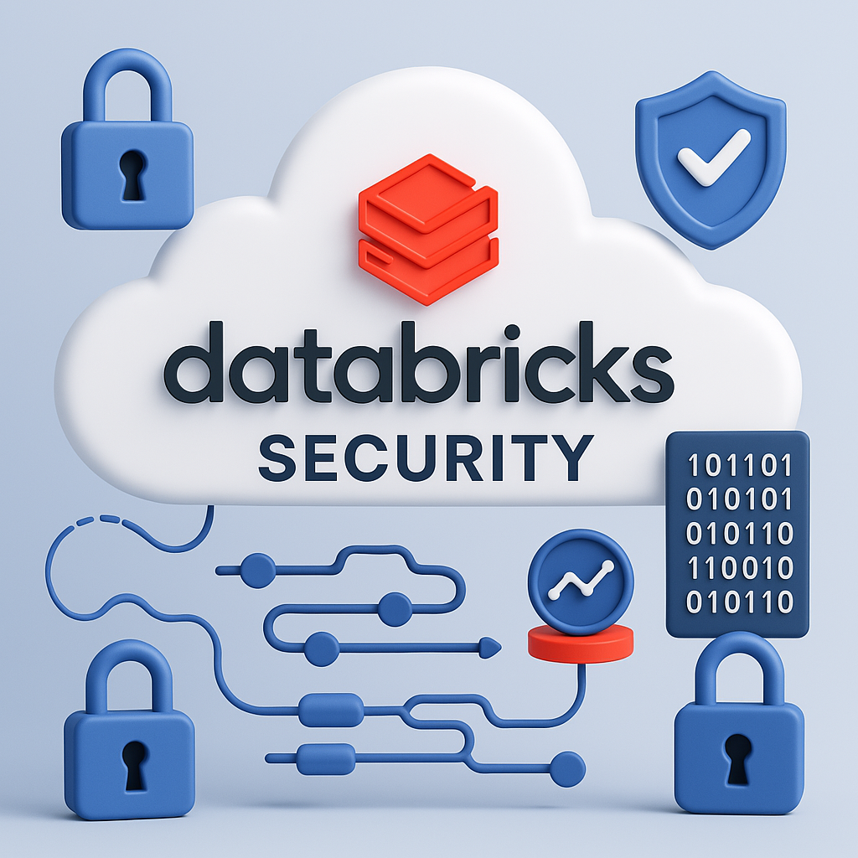
How secure is your Azure Databricks? Let’s find out
Fabian Gutierrez Ardts
Data Saturday Oslo 2025

Slide 2







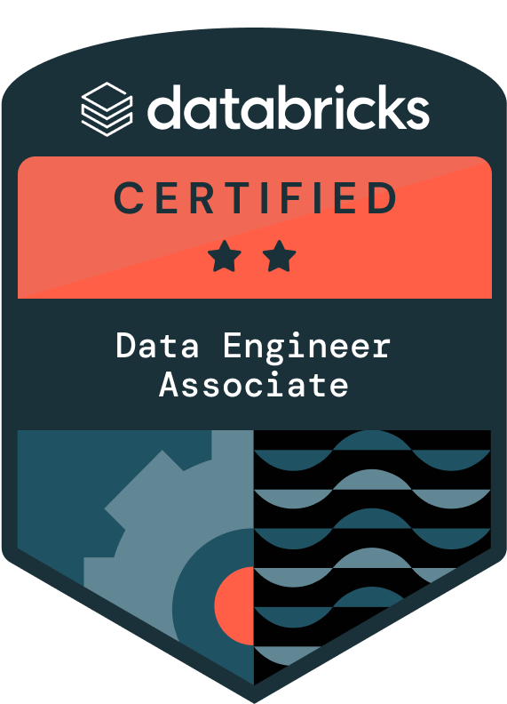


Fabian Gutierrez Ardts
Consultant | Azure & Databricks Data Engineer | Freelancer
20 years in the IT world, almost 15 years in Data world
Data Communities, Outdoor activities & travelling
linkedin.com/in/fabiangutierrezardts/
@FreeYourDataCon
github.com/FreeYourData
freeyourdata.nl

Slide 3

Why talk about databricks SECURITY?
Working with my costumers, I came across several challenges trying to introduce or implement (Azure) Databricks when getting approval from C/ISO (Chief / Information Security Officer) and Architects.
Databricks and Microsoft provided me with valuable information and a powerful Tool to overcome this challenges so that I could collect and present evidence and gain approvals.

Slide 4
TOPICS
SAT Background
Let’s install SAT
Evaluate and stay up to date
Extra Security Measurements

Slide 5

SAT background

Slide 6
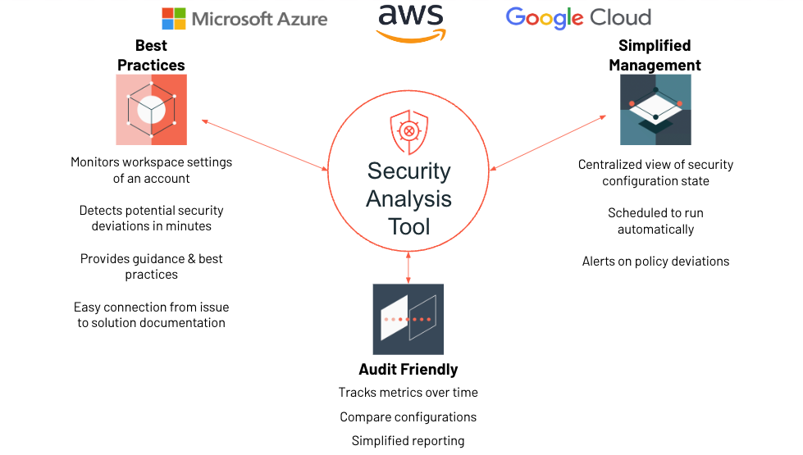
What is SaT?
It stands for Security Analysis Tool
SAT checks for typical security configurations deployed by most high-security organizations. It highlights the most significant risks, and those most frequently asked about by customers. Each recommendation will include a security configuration reference link to the relevant Databricks documentation.
Is an observability utility designed to improve the security posture of Databricks deployments. It helps customers identify deviations from established security best practices and monitor the security health of their Databricks workspaces.

Slide 7


Common Scenarios are: - your company requires constant security monitoring. - have INDUSTRY SECURITY best practices applied. - evaluate FROM account or INDIVIDUAL workspaces level. - provide key role security figures with tangible evidence.
When to use SAT?

Slide 8

SAT is not formally supported
“SAT is a productivity tool designed to help verify your security configurations against Databricks’ best practices. It is not intended to serve as a certification or formal attestation of your deployment's security posture.”
https://databricks-industry-solutions.github.io/security-analysis-tool/docs/motivation/
The code in this project is provided for exploration purposes only and is not formally supported by Databricks under any Service Level Agreements (SLAs). It is provided AS-IS, without any warranties or guarantees.

Slide 9





What is being monitored?
Network Security (NS)
Governance (GOV)
Data Protection (DP)
Identity & Access (IA)
Informational (INFO)

Slide 10
AND…extra SELF ASSESMENT CHECKs
Object storage encryption for data sources
Enable single sign-on
SCIM (System for Cross-Domain Identity Management) for user provisioning
Table Access Control for clusters that don't use Unity Catalog
Detect network peering of VPC (AWS, GCP) or VNet (Azure)

Slide 11
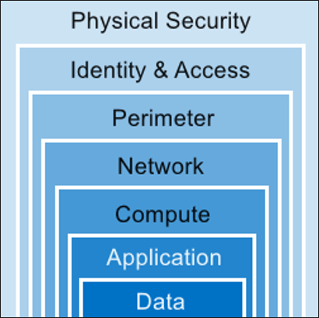

Comparing with defense in depth

Slide 12
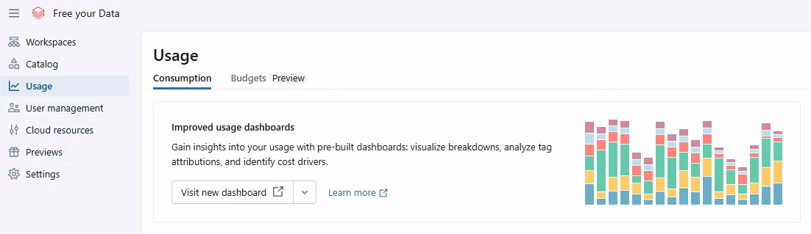
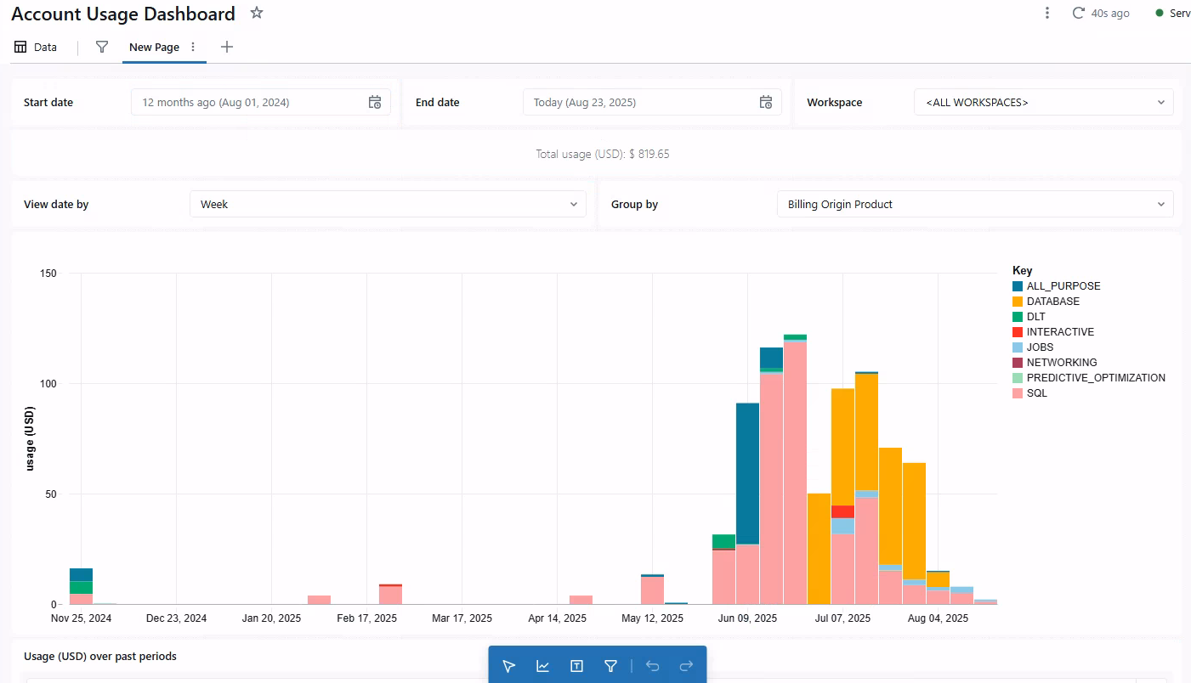
What is not monitored by SAT?....Costs
This is a separate feature offered from Account level and distribute as Dashboard to a target Workspace

Slide 13

LET’S INSTALL SAT

Slide 14
REQUIREMENTS
An Entra App Registry to be used as Identity with privilidge permission on
Azure Subscription Owner (RBAC)
Databricks Account
All Databricks Workspaces where analysis required.
Python 3.9 or higher
Databricks CLI installed with a profile logged.
Databricks SQL Warehouse (To run the SQL dashboard)
PyPI access from your workspace (To install the SAT utility library)
https://pypi.org/project/dbl-sat-sdk/
You can also modify SAT code to handle isolated installation if your workspace has no Public access

Slide 15

EXTRA REQUIREMENTS
Databricks Configuration file (.dabrickscfg).
Not mandatory but good advise, have a dedicated monitoring workspace to host the solution.
This will help you to have centralized SAT solution.
Compute within isolated workspace.
GitHub company (preferences) account or individual account.
This will be very helpful when questions or possibles issues.
Knowledge handling DABS (Databricks Asset Bundles)
Micro Bundles

Slide 16
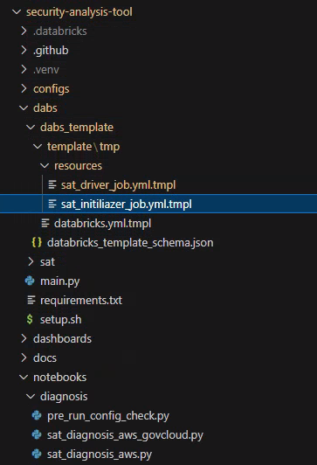
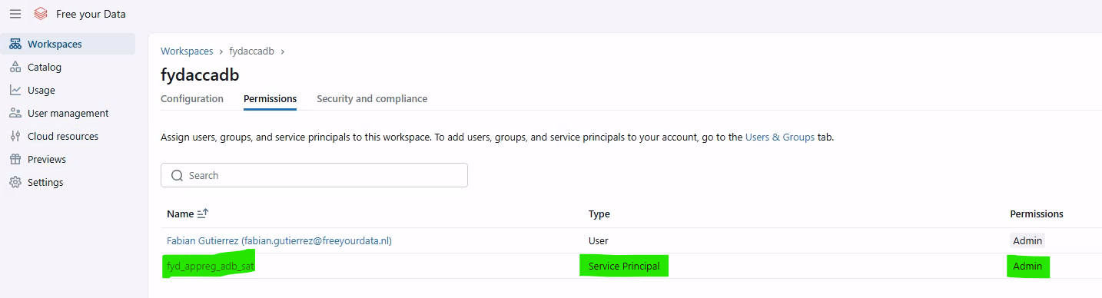
BEFORE installing SAT
Study the Job YAML and adjust the Workers type that suits your region and Compute usage.
Adjust job cluster via:
Source Code \ dabs \ dabs_template \ template \ tmp \ resources \ sat_initializer_job.yml.tmpl
\ sat_driver_job.yml.tmpl
Provide Workspace admin access to Service account to all workspace where analysis required.

Slide 17
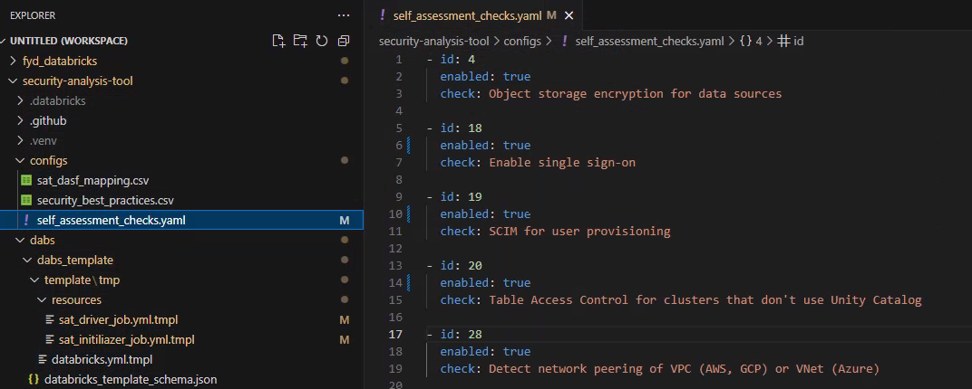
Before installing sat
If you are familiar with the (manual) self assessments checks, then you can enable them before installing or after. It depends on what you want to evaluate.

Slide 18
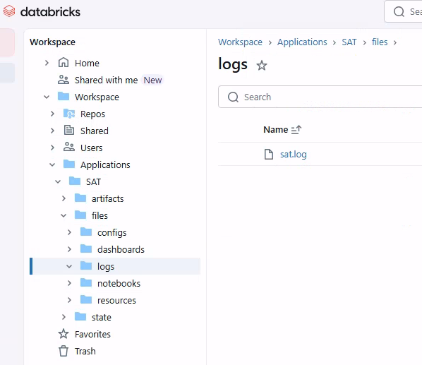
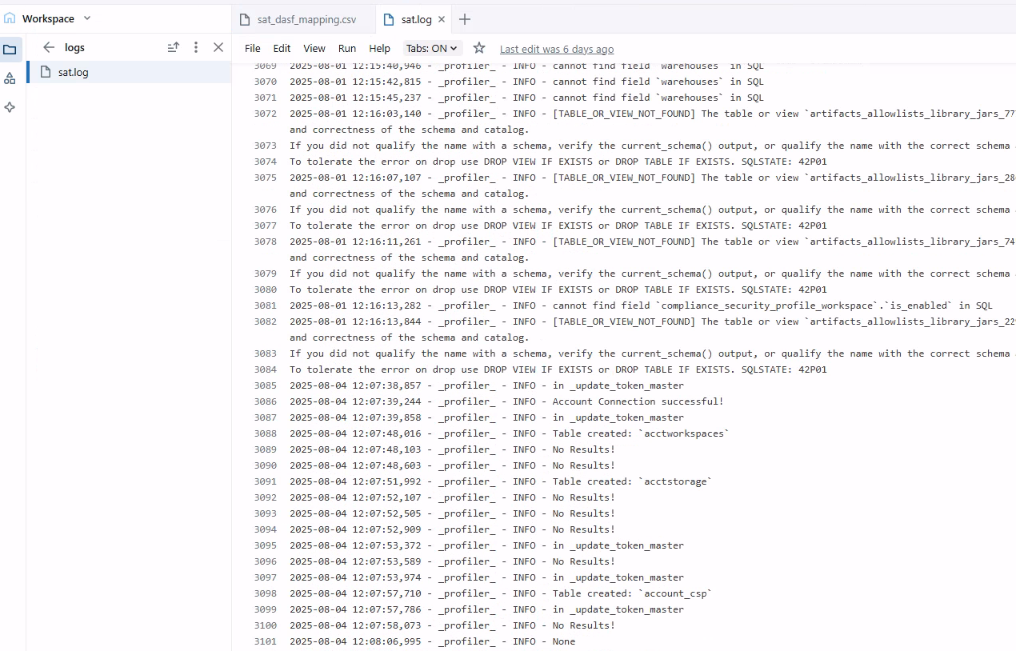
DURING installation
Logging (Workspace -> logs)

Slide 19
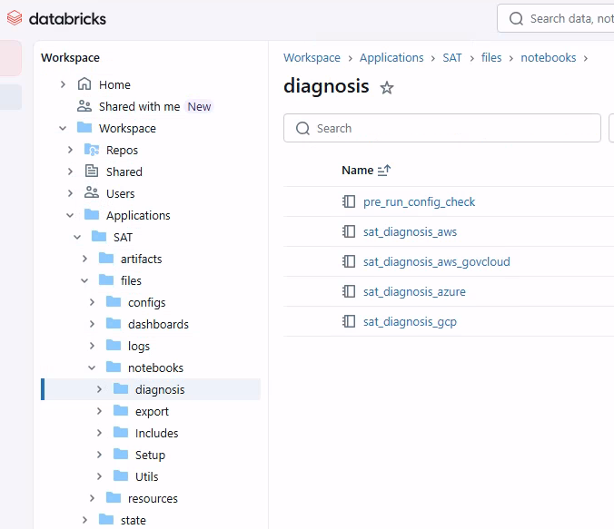
During installation
Make use of Diagnosis Notebooks to troubleshoot during installation.
Very helpful when fixing installation/configuration issues.

Slide 20
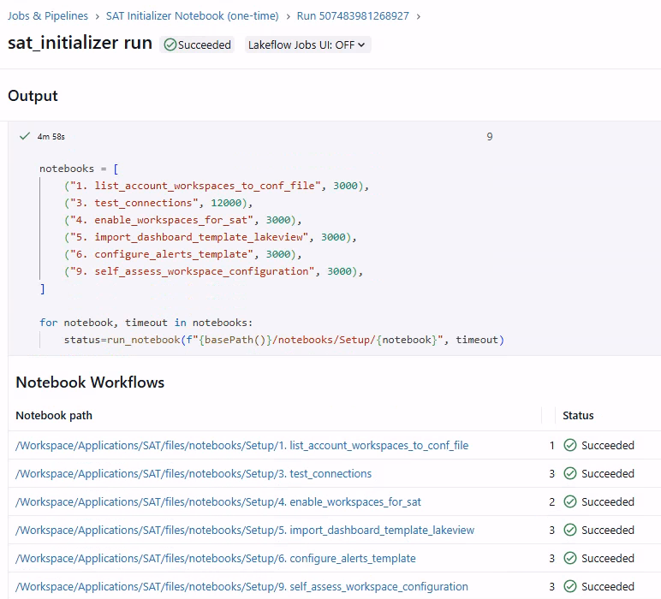
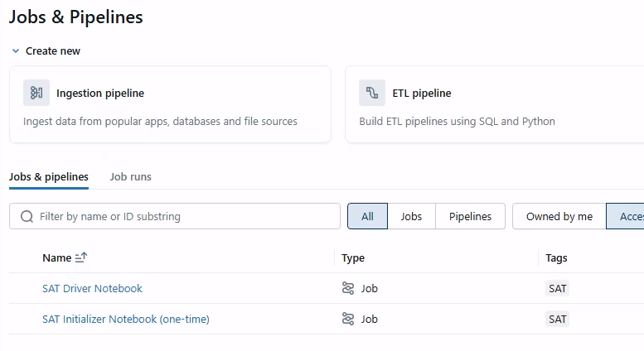
AFTER installing sat
In case of errors, use again Diagnosis Notebooks
Run Jobs:
- Initial Job [ Manual Execution & 1 time only ]
- SAT Driver [ 3 days a week Mo-Wed-Fr ]

Slide 21
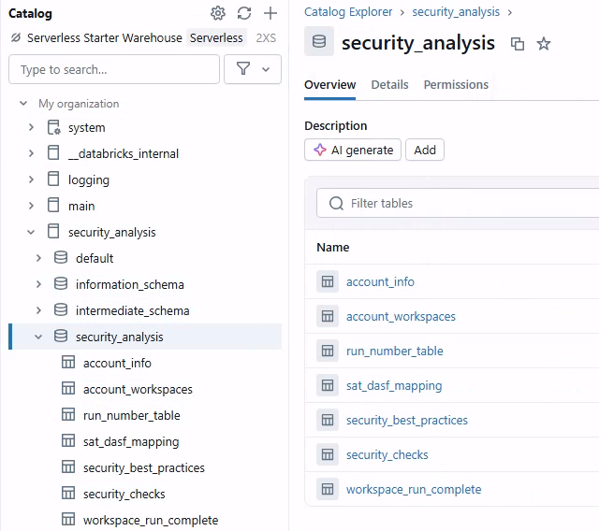
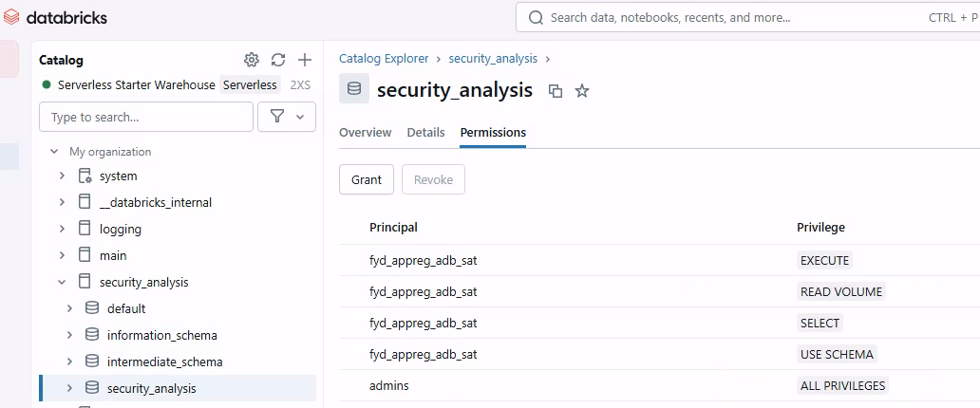
AFTER installing sat
Explorer Catalog: Where all this information stored
Ensure the users have the necessary privileges on
Schema level to ensure they can read data.

Slide 22

DEMO TIME

Slide 23

Evaluate and stay up to date

Slide 24
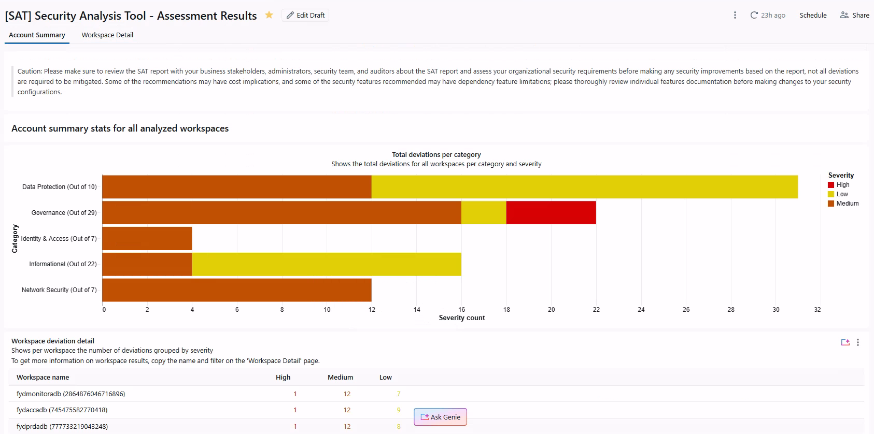
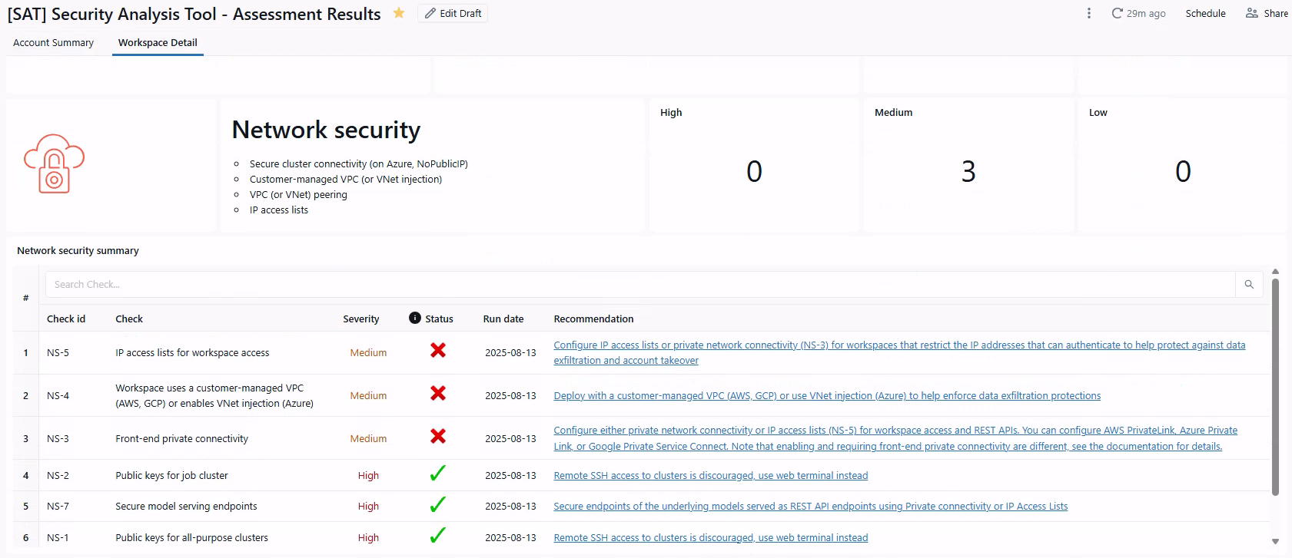
ASSEST Security ANALYSIS
Account summary
Per Workspace

Slide 25
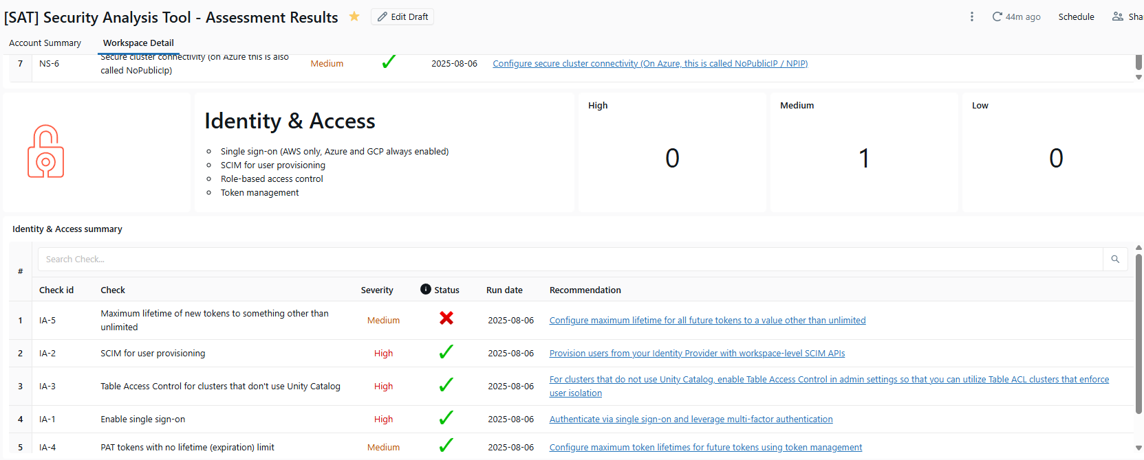
Applying security measurements
Each check is provided with an recommendation and a link to the solution page. Follow the instructions, apply changes where required and on this next job run the status will be updated.

Slide 26
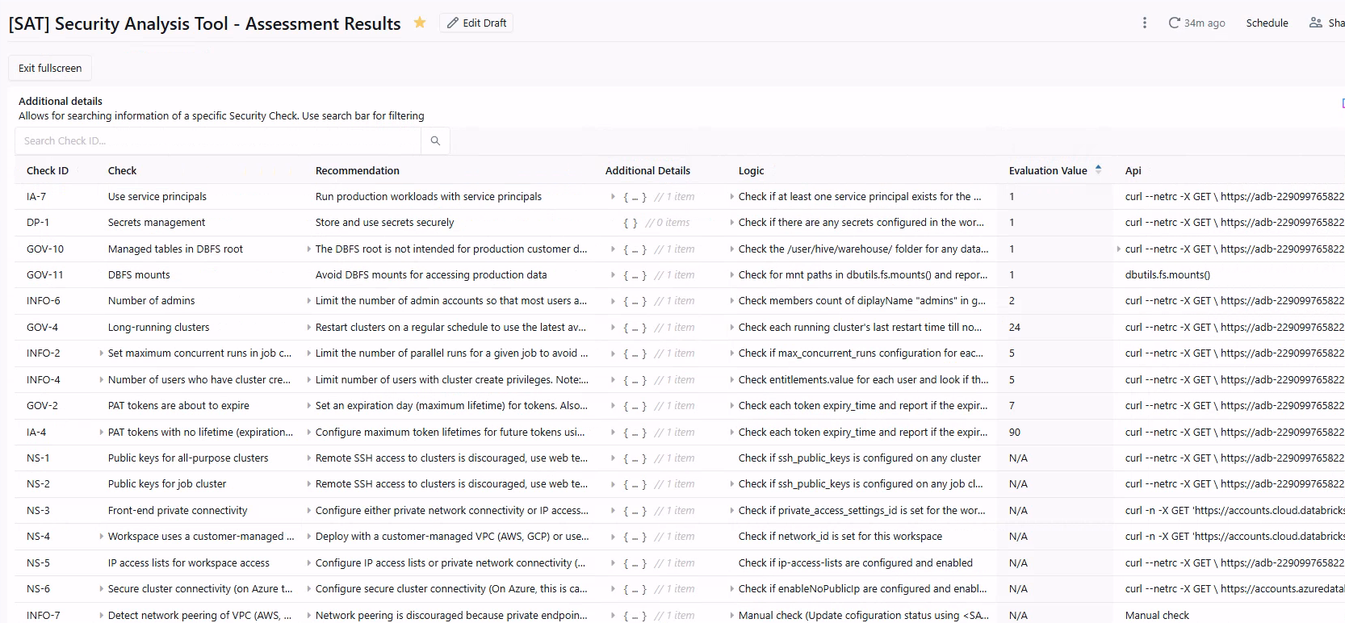
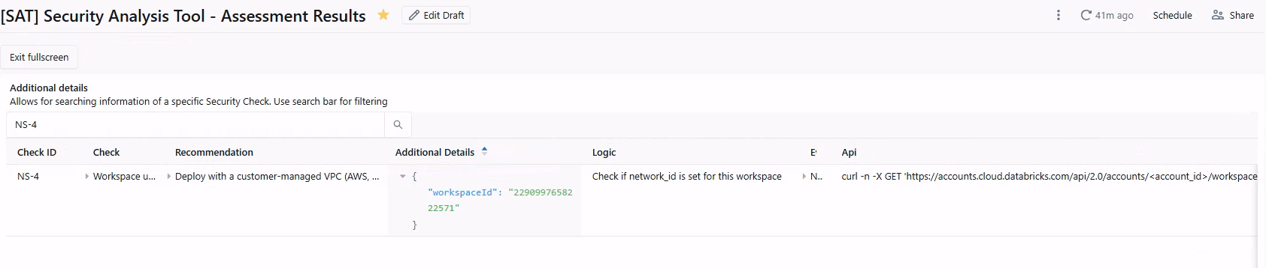
Additional details
Use this to get details on what caused a check to fail.

Slide 27
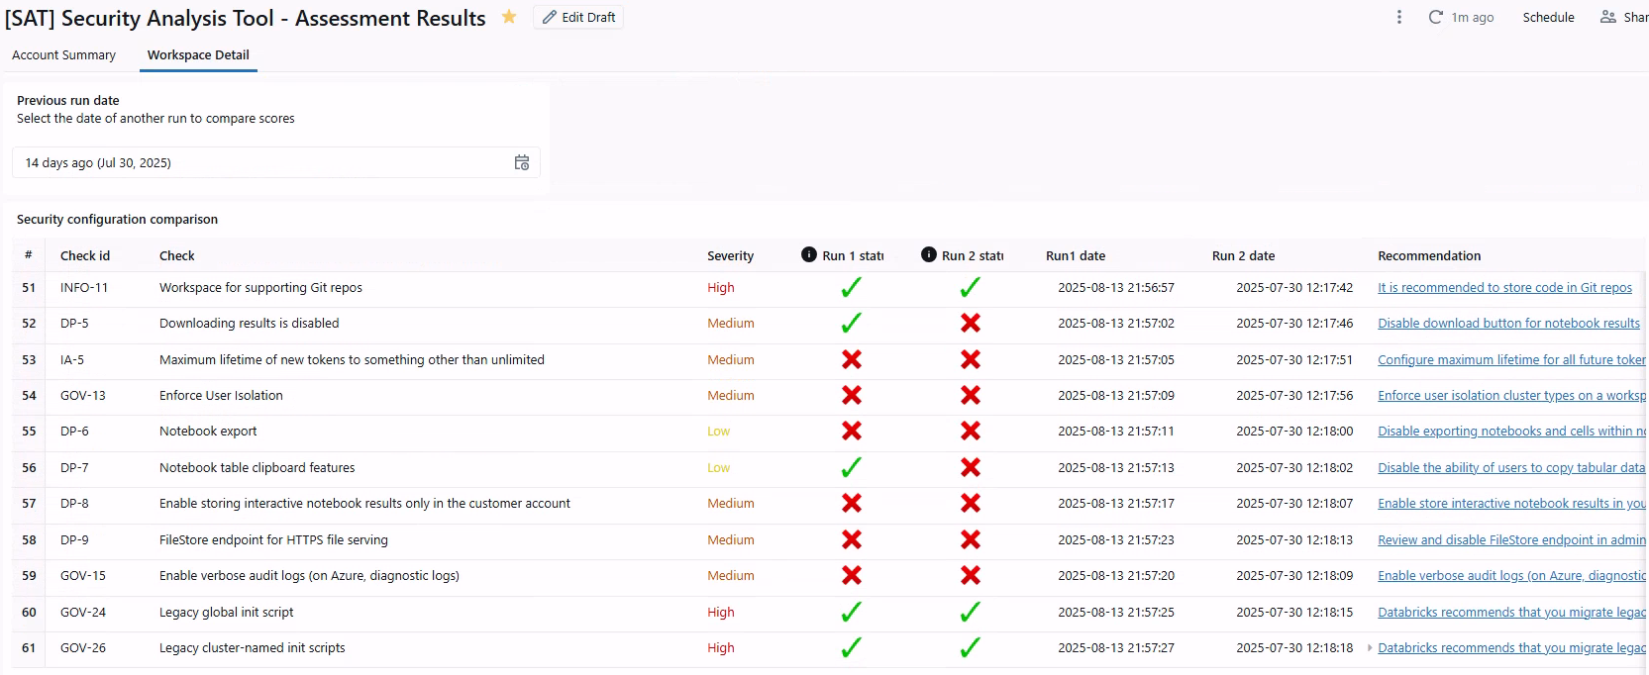
Compare evaluations by dates
Its possible to compare 2 different run dates to track progress or deterioration of Workspaces as changes get applied or omitted.

Slide 28
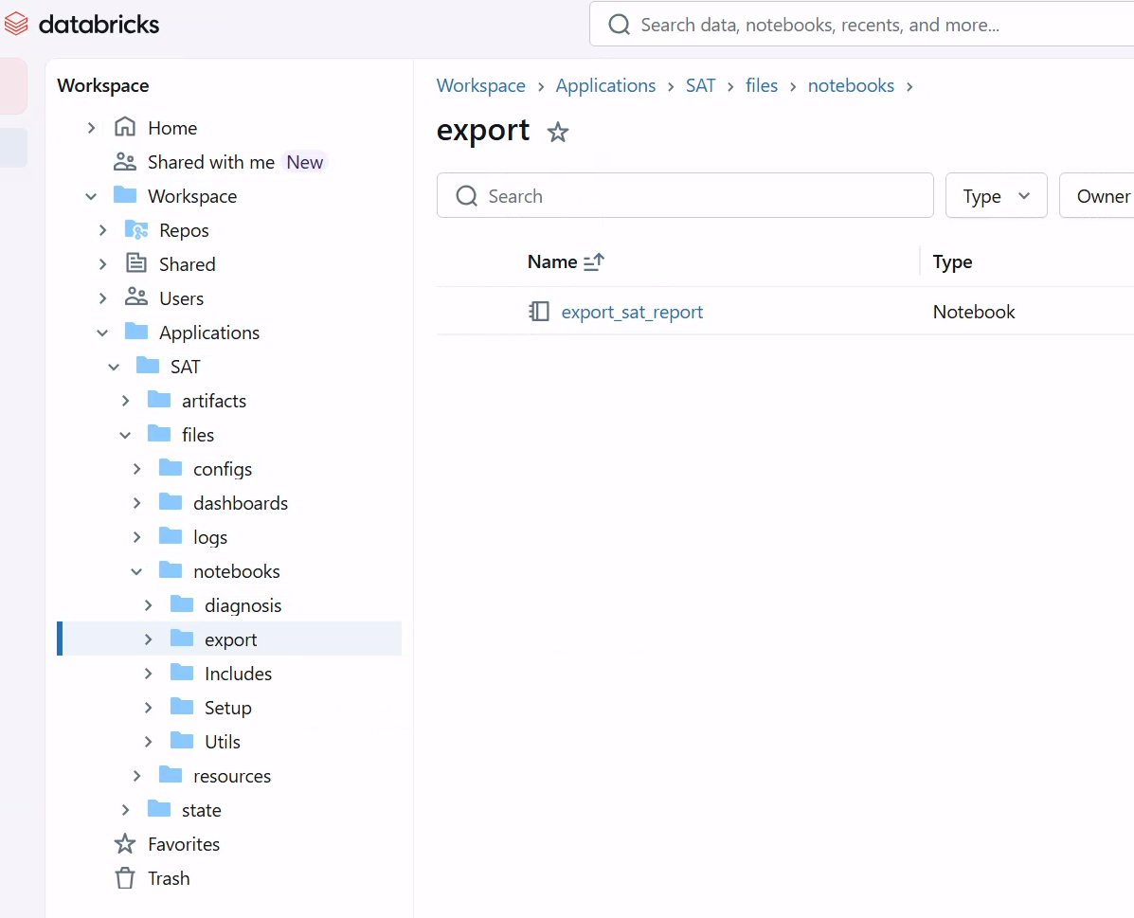
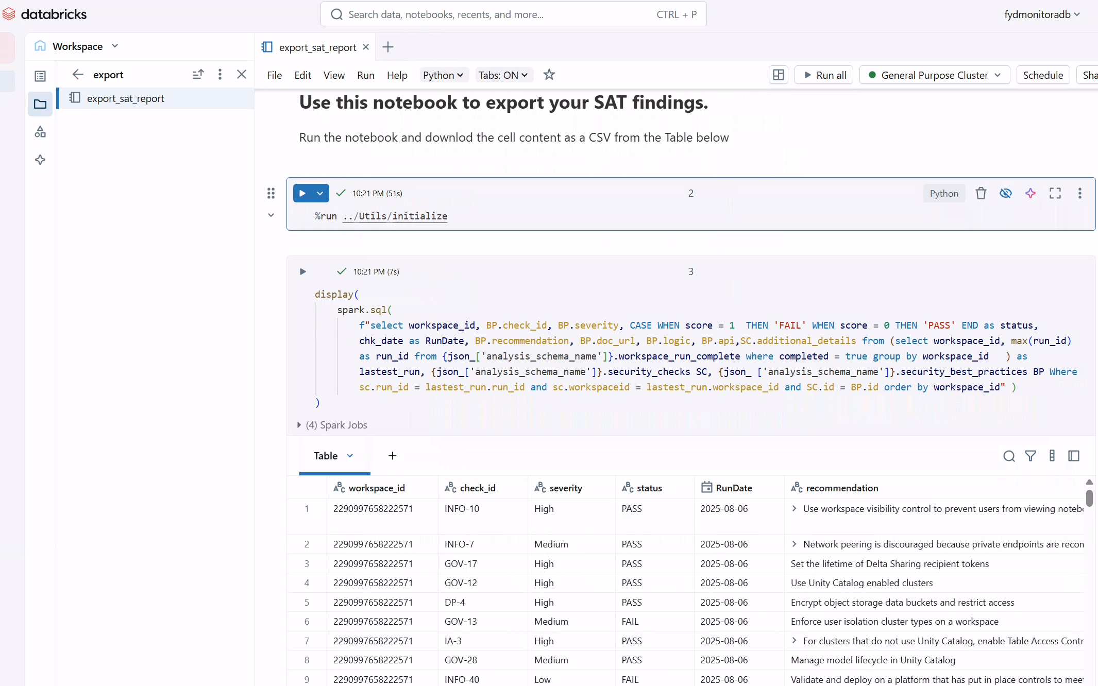
EXPORTS
Export all Workspaces, unless you modify the query.
Status based on >= 1 within the query.

Slide 29
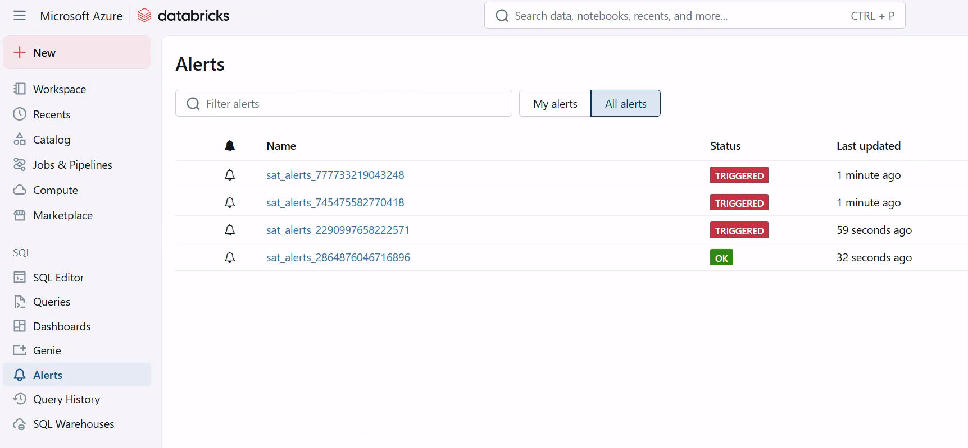
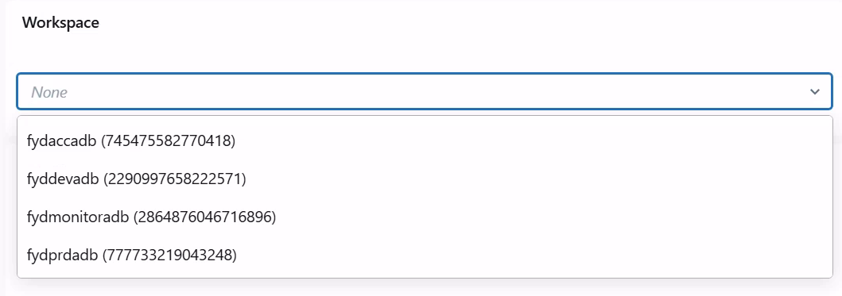
ALERTS
1 alert per Workspace.
Recommendation change the status to ‘OK’ if 0 rows returned, otherwise default status ‘Unknown’.

Slide 30
New release 0.4.0 available as of 12-aug
Key Updates: ✅ Simplified GCP setup with Service Principal ✅ AWS GovCloud support ✅ SAT tagging for deployed jobs ✅ Fixes for Azure diagnostics logs check & Azure account API checks ✅ Documentation improvements for smoother onboarding ✅ Many bug fixes These enhancements make SAT more robust across GCP, AWS (including GovCloud), and Azure, and help customers adopt it with reduced setup process.

Slide 31
DEMO TIME

Slide 32

Extra Security MeasuREments

Slide 33
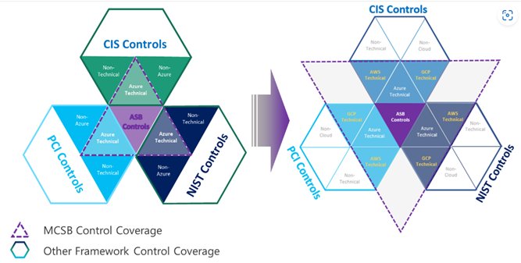
Azure Security Baseline for Azure Databricks
This security baseline applies guidance from the Microsoft cloud security benchmark version 1.0 to Azure Databricks. The Microsoft cloud security benchmark provides recommendations on how you can secure your cloud solutions on Azure. The content is grouped by the security controls defined by the Microsoft cloud security benchmark and the related guidance applicable to Azure Databricks.

Slide 34

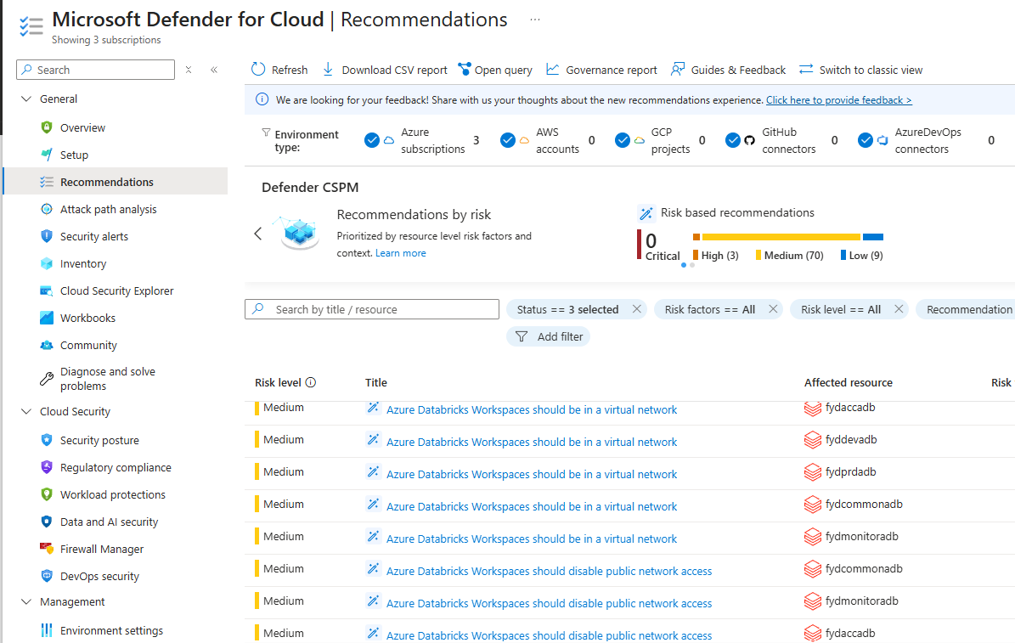
Azure Security Baseline for Azure Databricks
You can monitor this security baseline and its recommendations using Microsoft Defender for Cloud. Azure Policy definitions will be listed in the Regulatory Compliance section of the Microsoft Defender for Cloud portal page.

Slide 35

WRAP UP

Slide 36
Take aways are..
SAT is a powerful tool that helps us analyse and monitor Databricks security best-practices measurements.
In the process of setting SAT up, you can configure it to beter suit your environment.
Provides simple and yet concise reporting solution to evaluate Security
It allows us to share information for other Workspace members to take action.
Open source and direct contact with the SAT team, as well as Contributions from the community.
Together with Microsoft, we get a full security coverage for Azure and Databricks.

Slide 37

ReferEnces
Security Analysis Tool
https://www.databricks.com/blog/announcing-security-analysis-tool-sat
https://databricks-industry-solutions.github.io/security-analysis-tool/docs/installation/standard/azure/
https://pypi.org/project/dbl-sat-sdk/
Databricks GitHub
https://github.com/databricks
https://github.com/databricks-industry-solutions/security-analysis-tool
Databricks Asset Bundle
https://github.com/databricks/databricks-asset-bundles-dais2023
https://learn.microsoft.com/en-us/azure/databricks/dev-tools/bundles/
https://learn.microsoft.com/en-us/azure/databricks/dev-tools/bundles/variables
Azure Security Baseline
https://learn.microsoft.com/en-us/security/benchmark/azure/baselines/azure-databricks-security-baseline

Slide 38

Thank you!
Stay in contact
linkedin.com/in/fabiangutierrezardts/
@FreeYourDataCon
github.com/FreeYourData
fabian.gutierrez@freeyourdata.nl

Slide 39
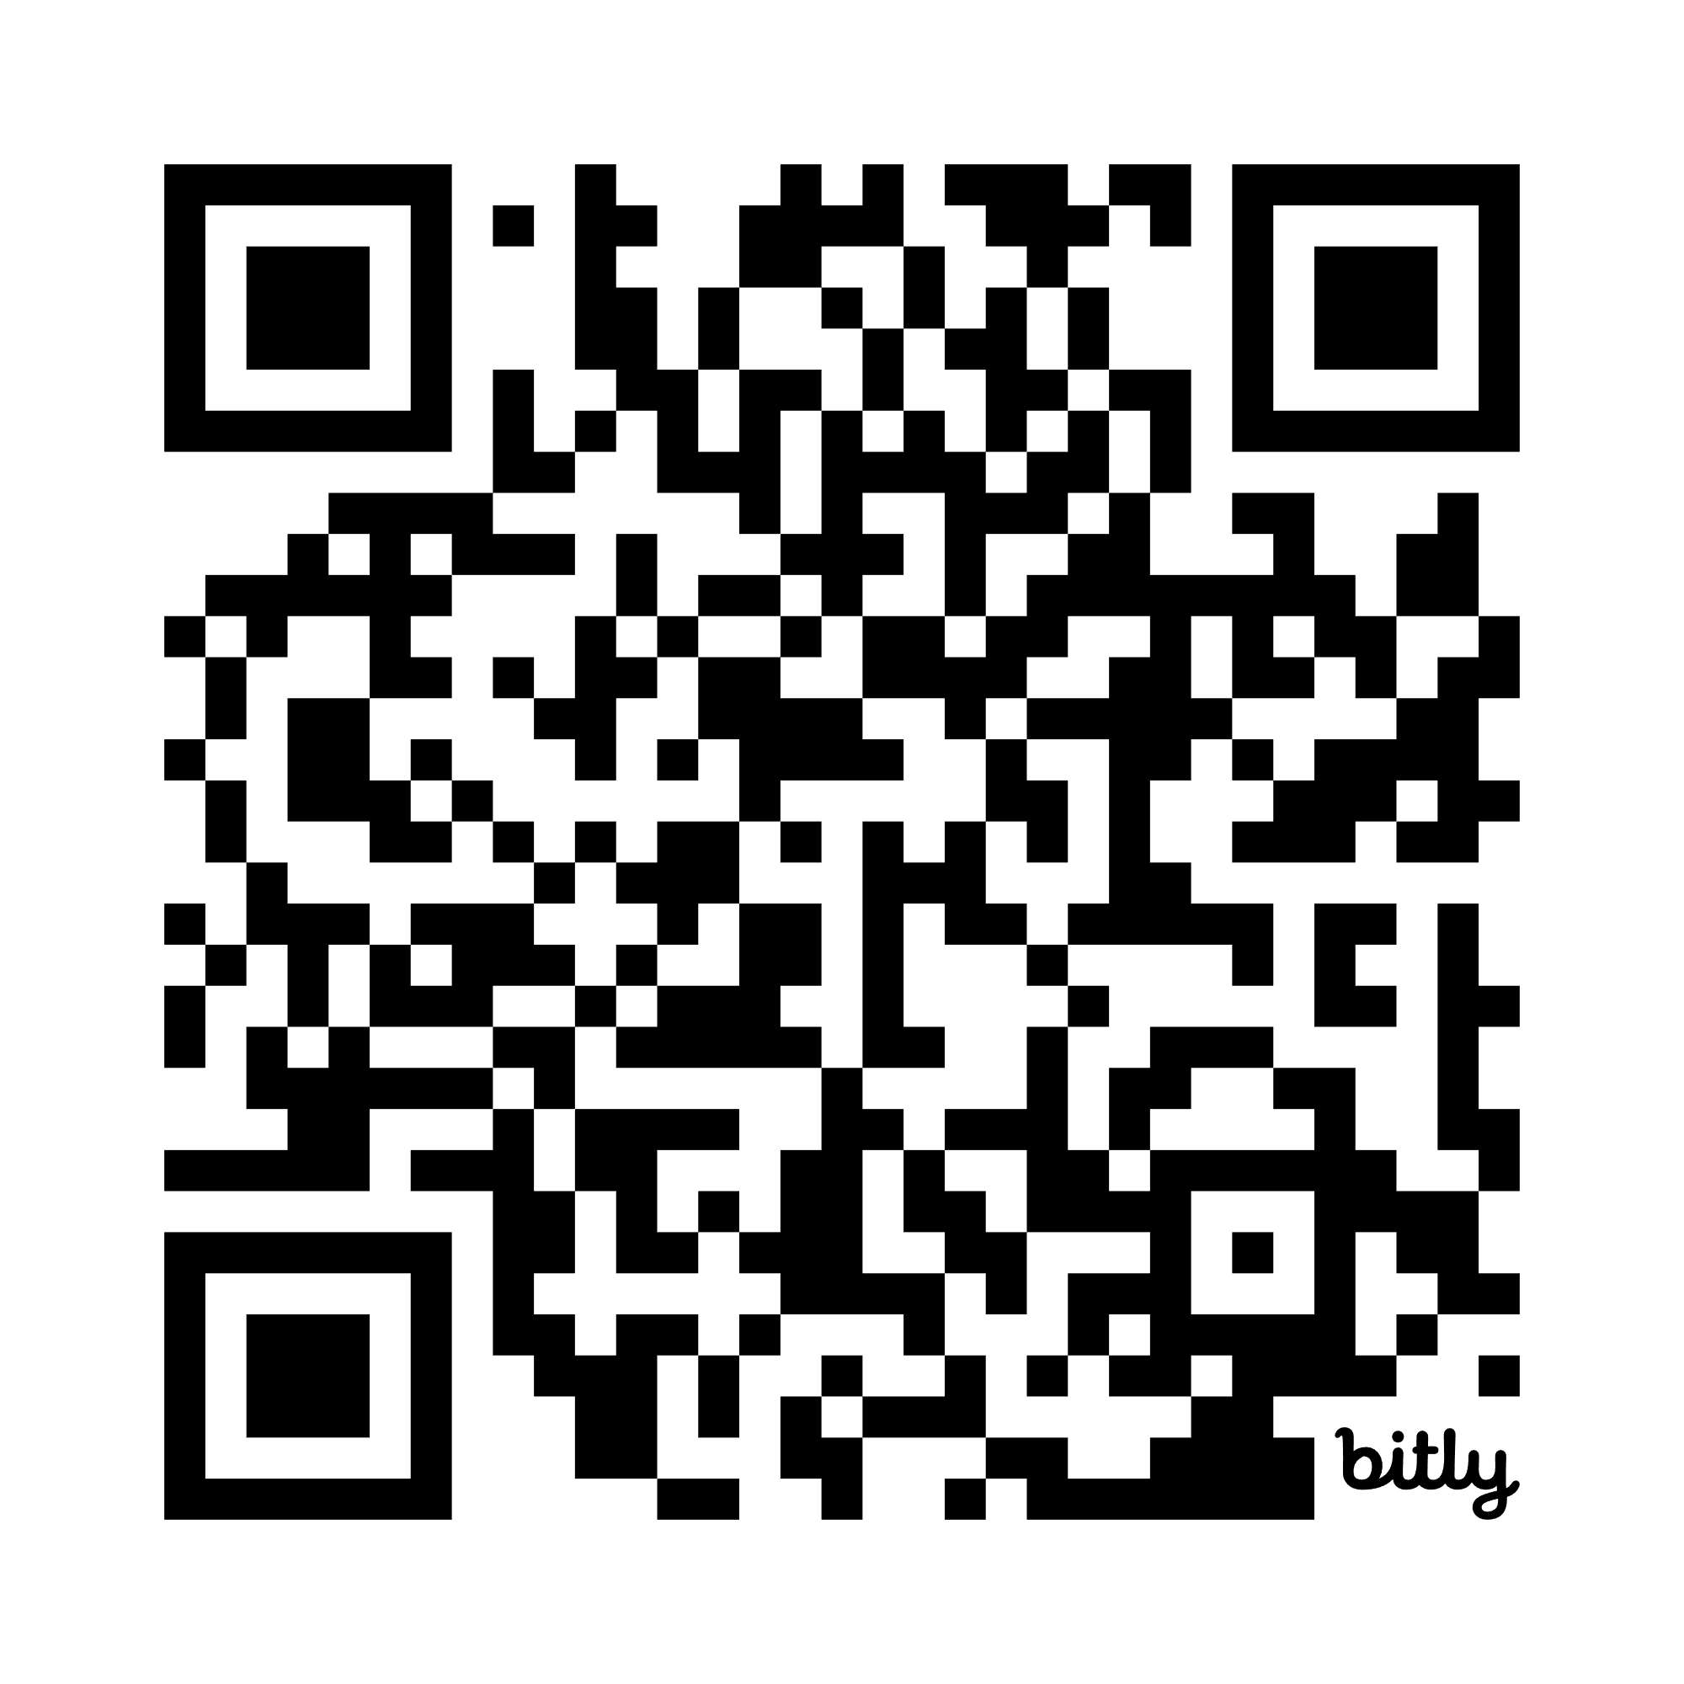
Please give your feedback via <>
Stay in contact
linkedin.com/in/fabiangutierrezardts/
@FreeYourDataCon
github.com/FreeYourData
fabian.gutierrez@freeyourdata.nl

